Slide 1
Building iOS Swift apps
5030-201720_MCS5993_M: 5030-Topics in Computer Science
5031-201720_MCS4993_M: 5031-Topics in MA/CS

Slide 2
Agenda
Continuous Integration
Notes:
Show remarks in iTunesConnect

Slide 3
Agile Testing

Slide 4
Unit Tests should be First
F(ast)
I(solated)
R(epeatable)
S(elf-verifying)
T(imley)
Notes:
https://pragprog.com/magazines/2012-01/unit-tests-are-first

Slide 5
Tools of the trade – Last lecture
GUI Testing - XCUI
API Testing – Postman & Newman
Unit Testing – XCTest & Cuckoo (Mocking)

Slide 6
Continuous Integration
Jenkins!!!

Slide 7
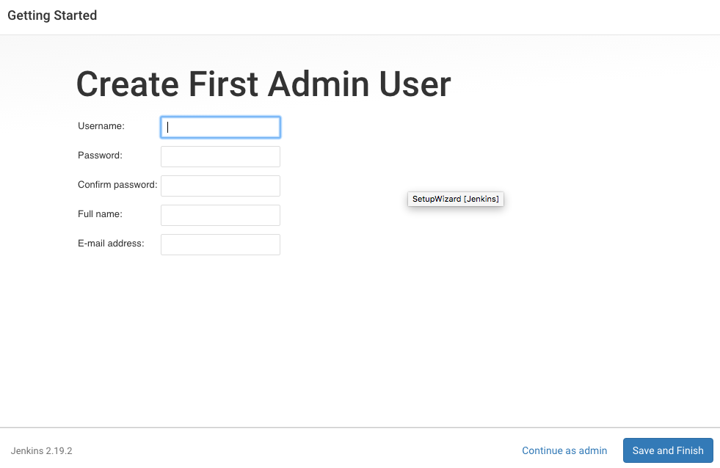
Jenkins

Slide 8
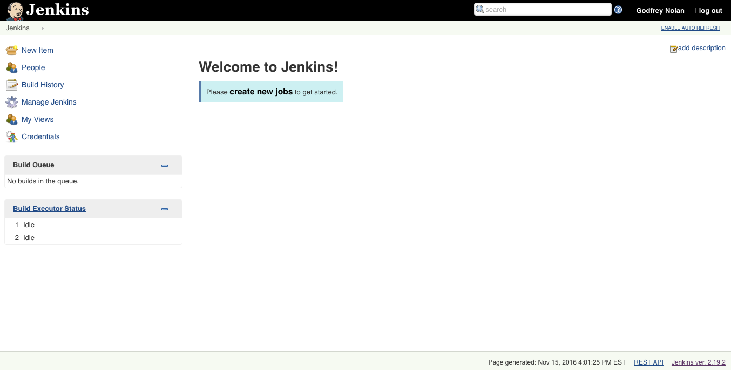
Jenkins

Slide 9
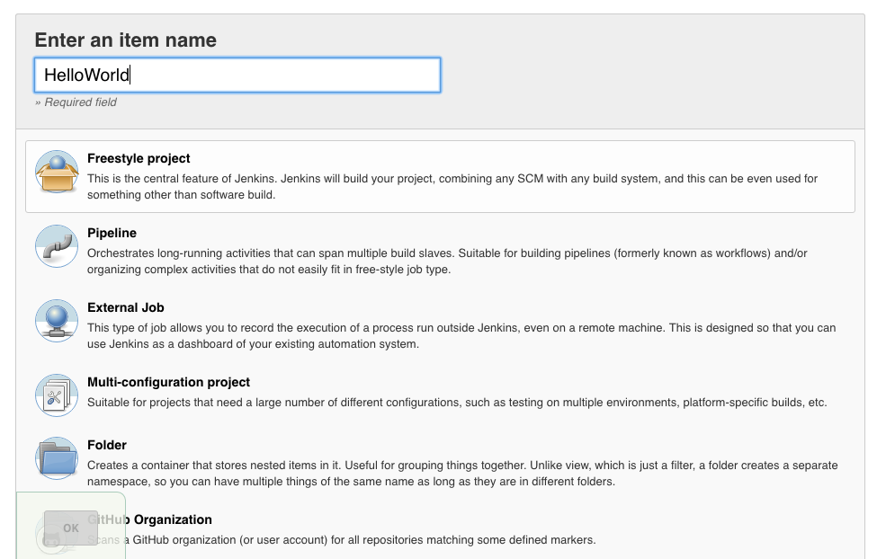
Jenkins
Notes:
Had to make it HelloWorldXcode

Slide 10
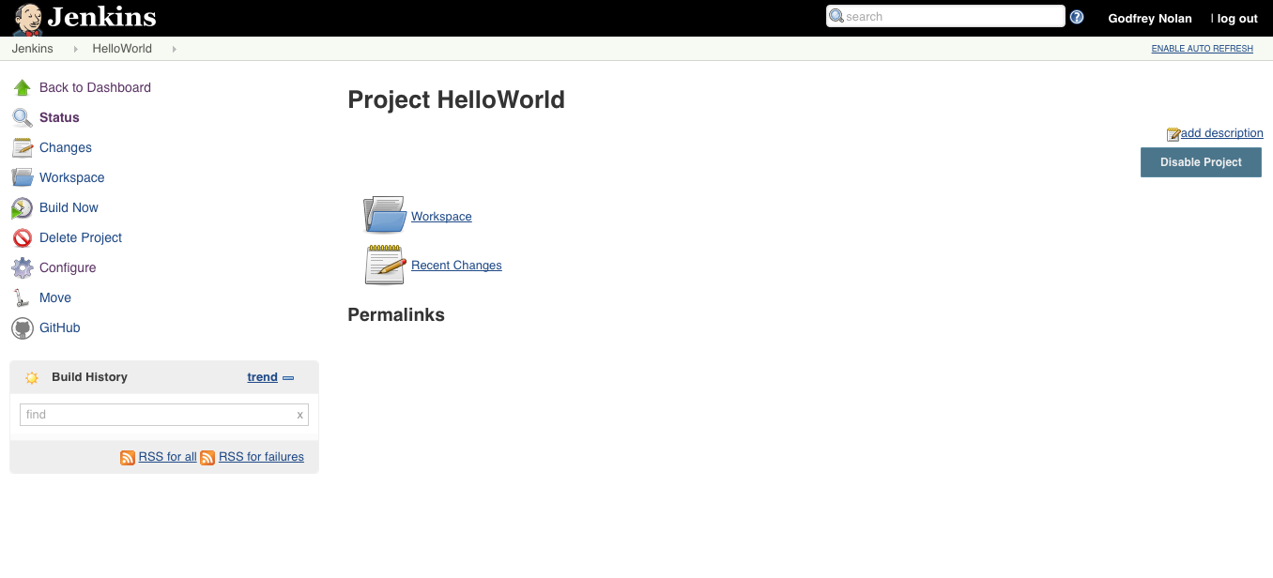
Jenkins

Slide 11
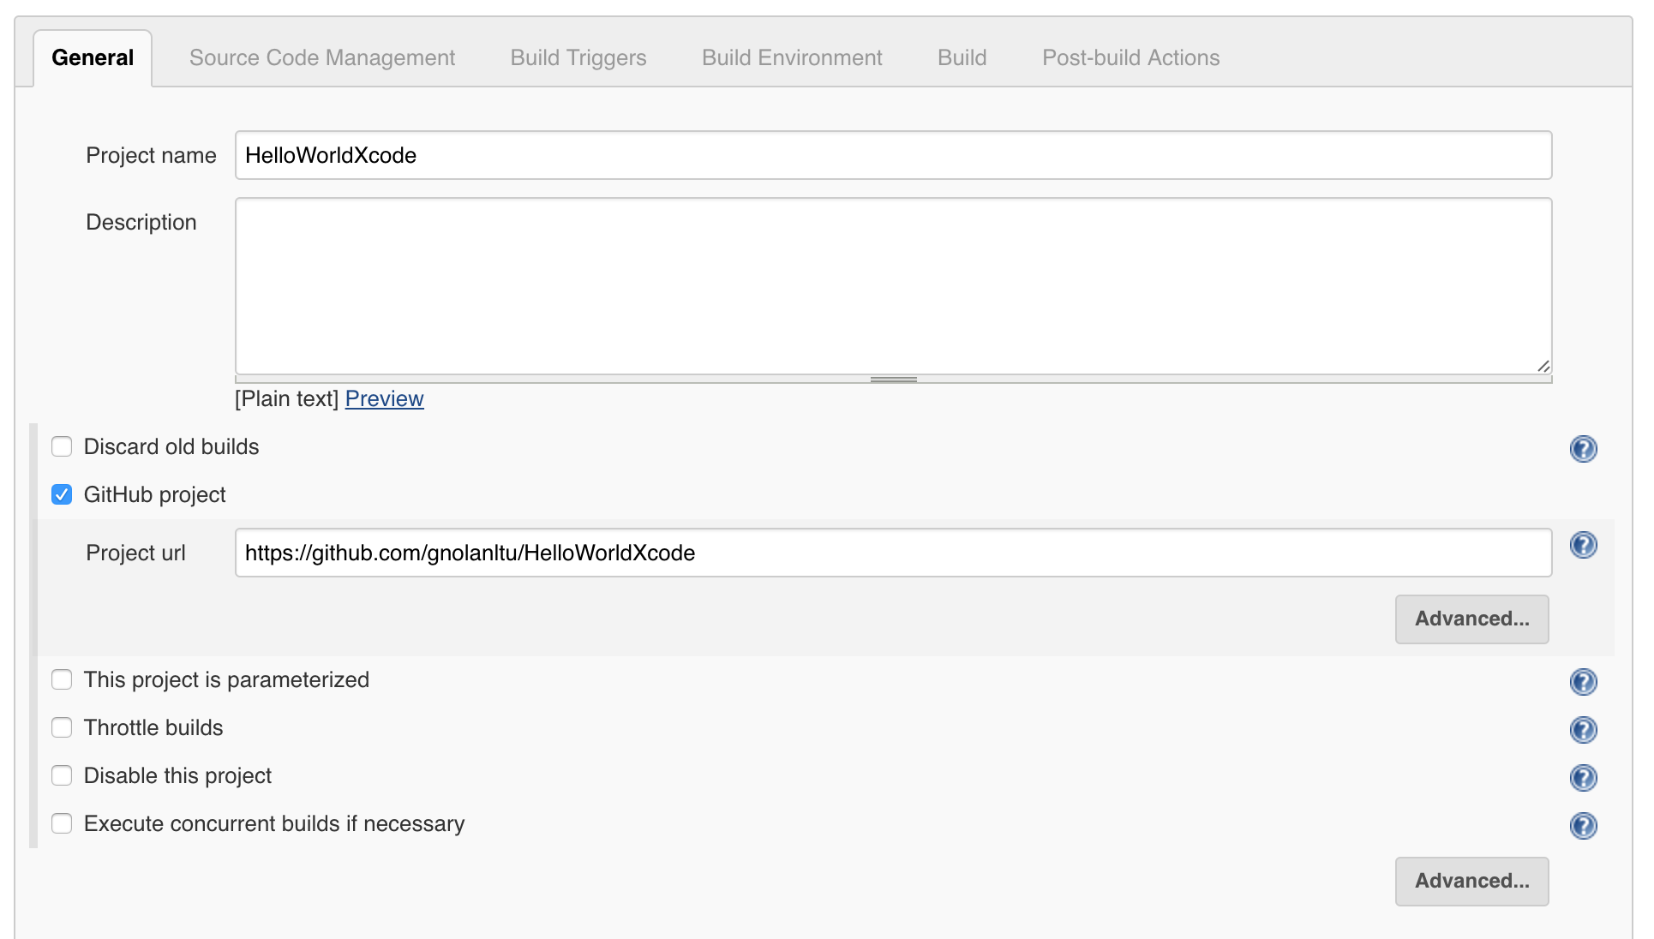
Jenkins

Slide 12
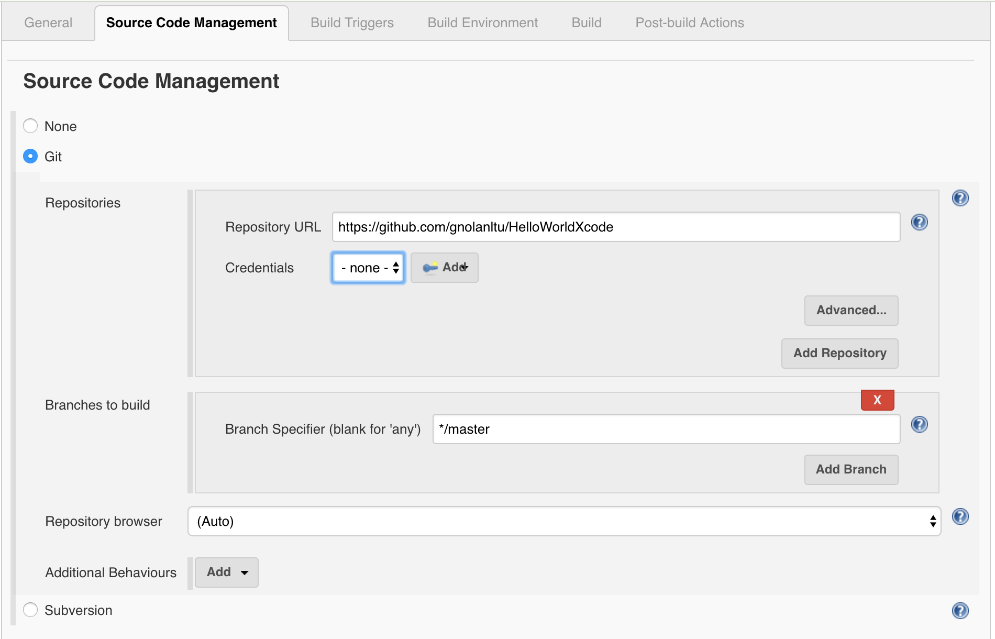
Jenkins

Slide 13
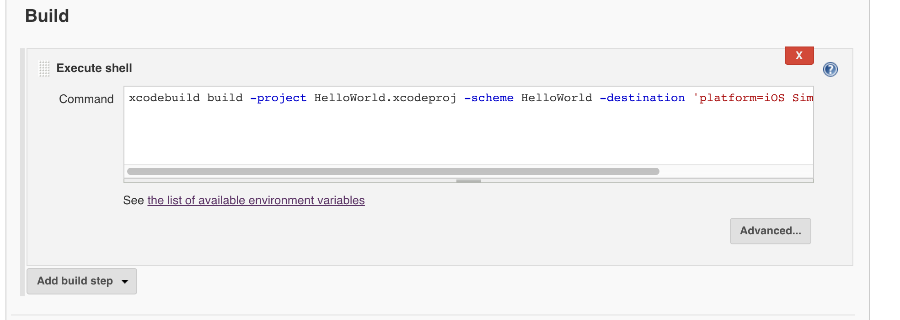
Jenkins

Slide 14
Commands
xcodebuild build -project HelloWorld.xcodeproj -scheme HelloWorld -destination 'platform=iOS Simulator,name=iPhone 7 Plus'

Slide 15
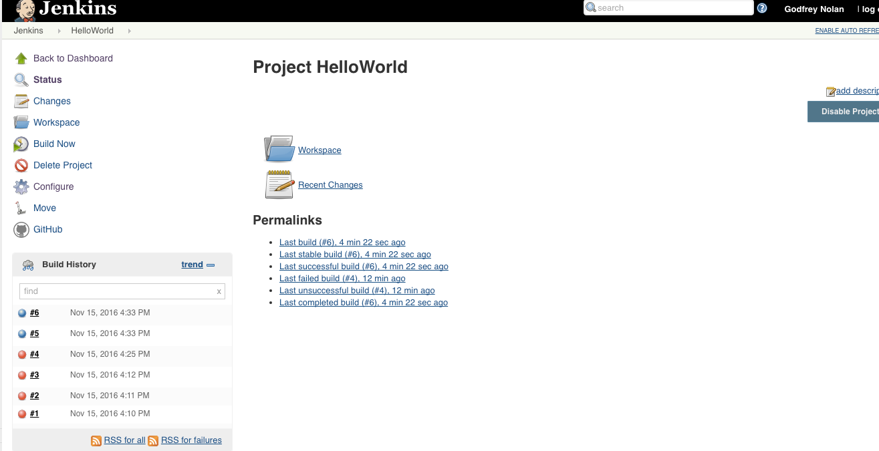
Jenkins

Slide 16
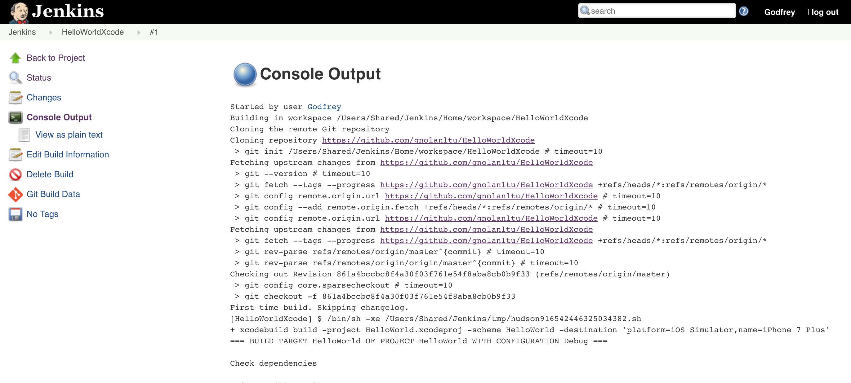
Jenkins

Slide 17
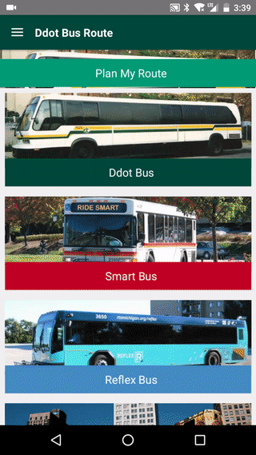
Sample app

Slide 18
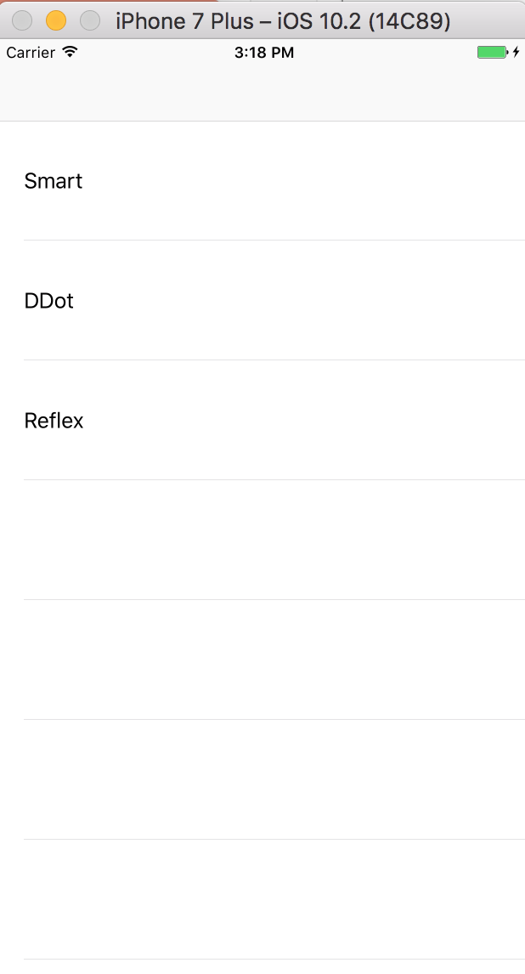
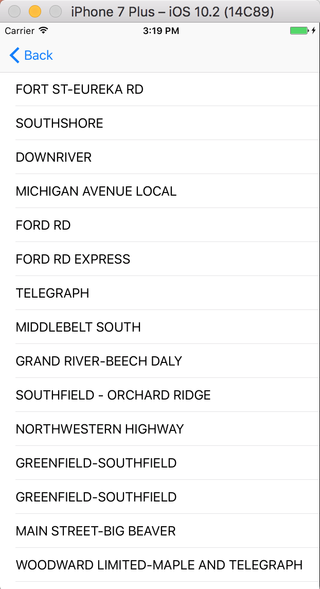
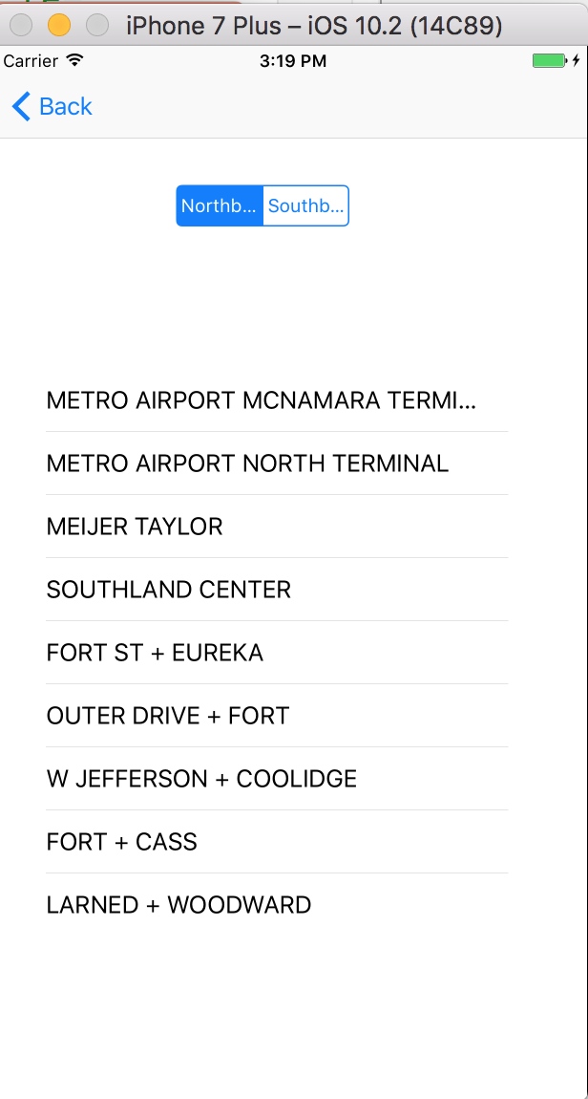
Sample app
Notes:
git clone http://github.com/dfreemanRIIS/ETAMock

Slide 19
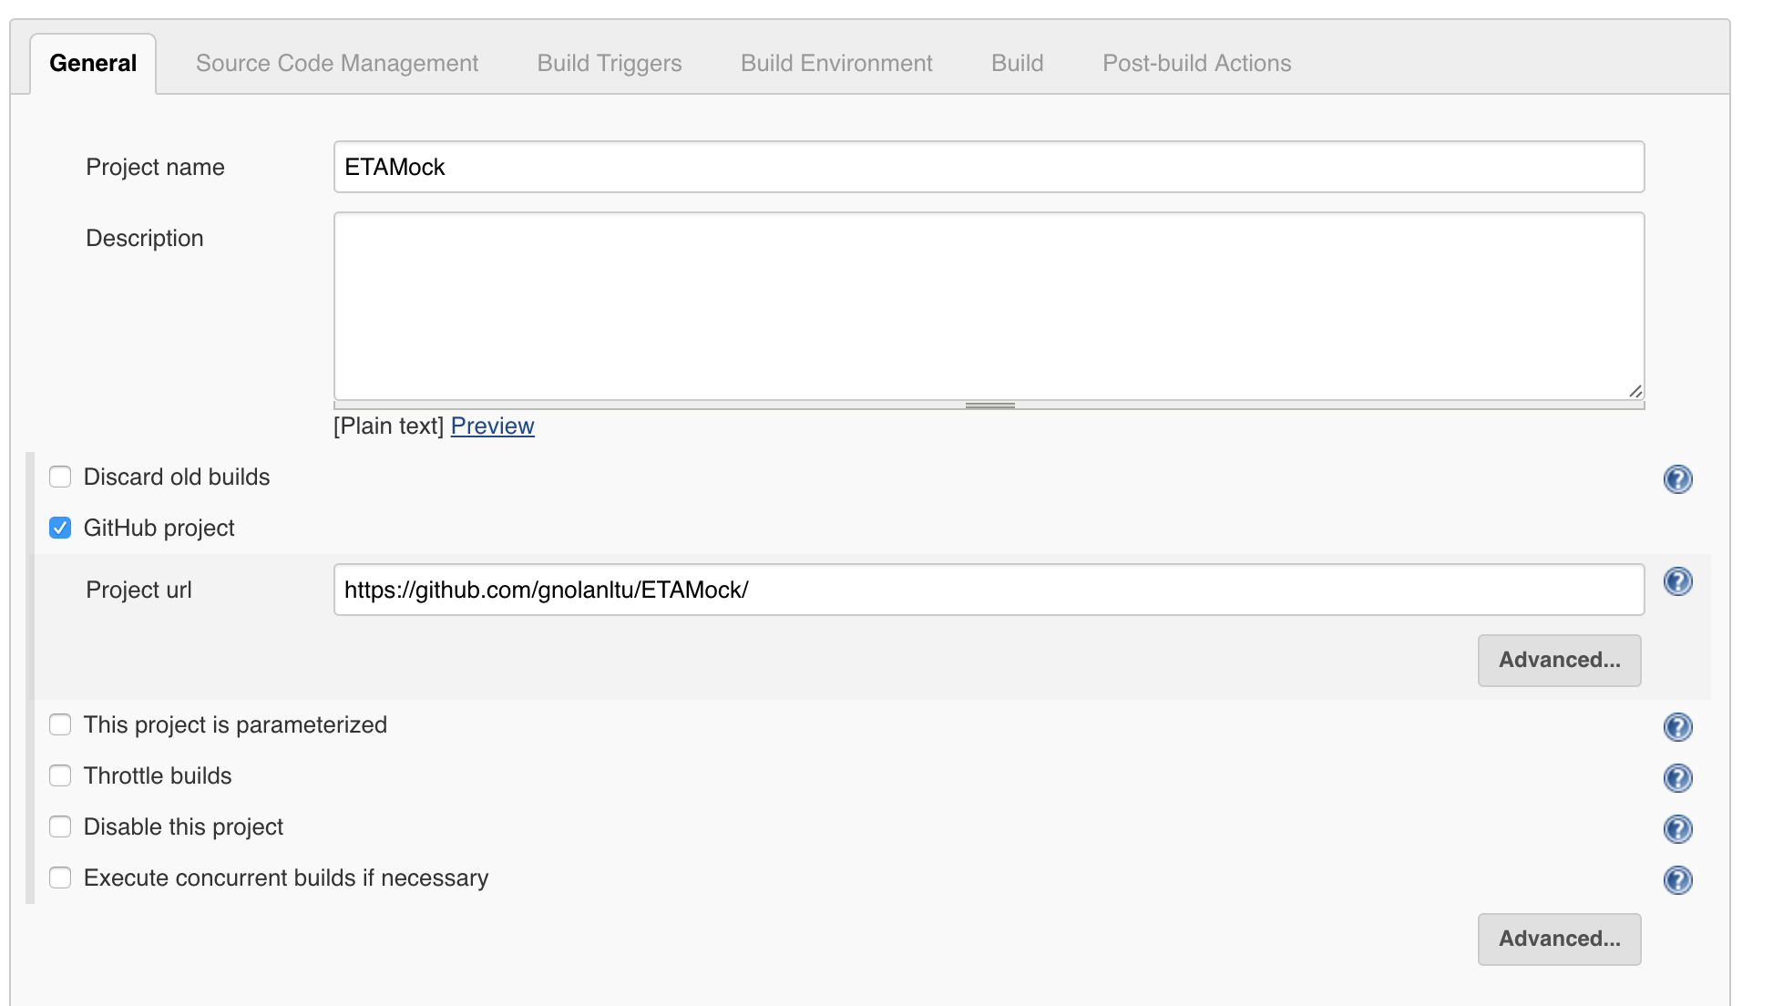
Xcode Build
Notes:
git clone http://github.com/dfreemanRIIS/ETAMock

Slide 20
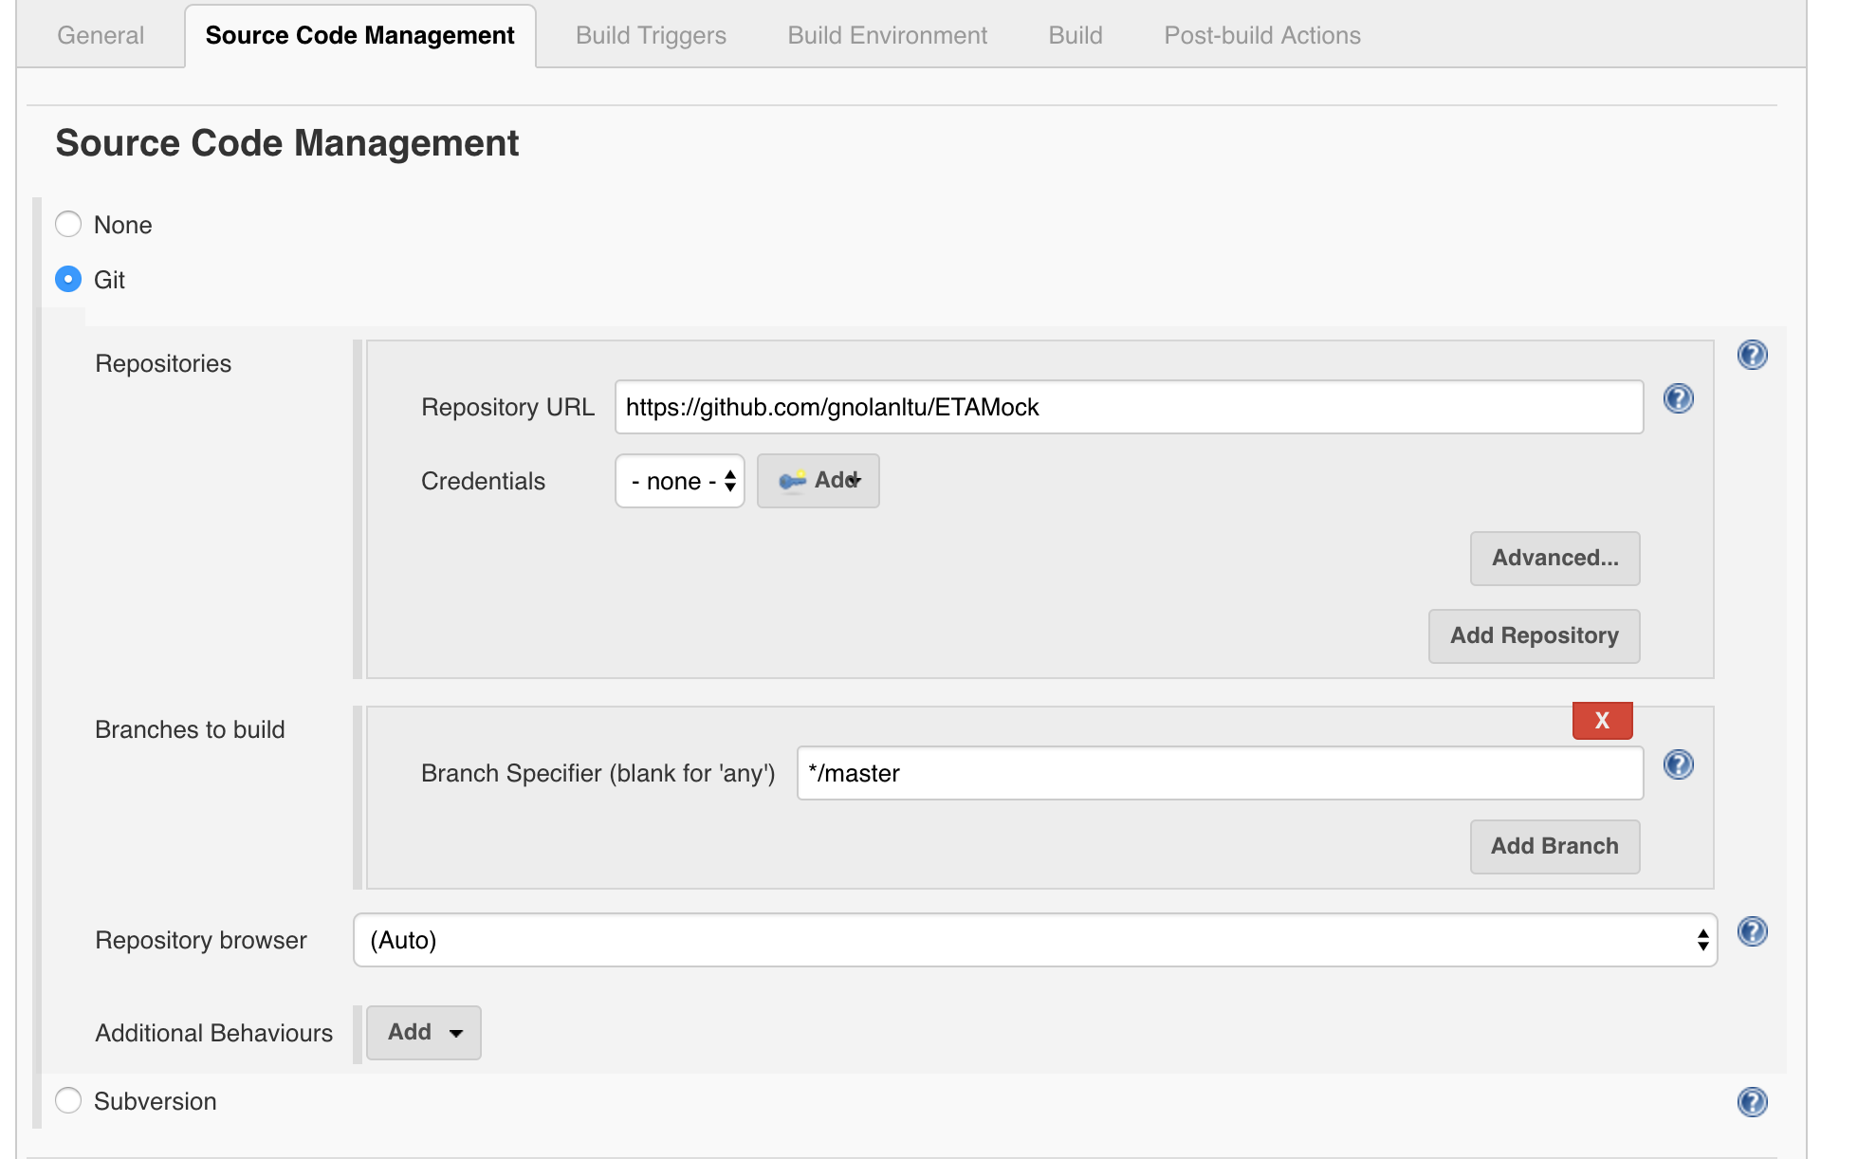
Xcode Build
Notes:
git clone http://github.com/dfreemanRIIS/ETAMock

Slide 21
Xcode Build
Notes:
git clone http://github.com/dfreemanRIIS/ETAMock

Slide 22
Commands
xcodebuild test -workspace ETAMock.xcworkspace -scheme ETAMock -destination 'platform=iOS Simulator,name=iPhone 7 Plus’
xcodebuild test -workspace ETAMock.xcworkspace -scheme ETAMock -destination 'platform=iOS Simulator,name=iPhone 7 Plus’ –only-testing:ETAMockTests

Slide 23
Agenda Tuesday
Test Driven Development - TDD

